Slide 1
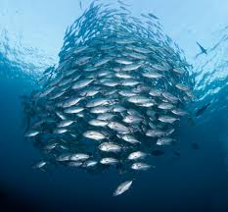
Lecture themes
Prototyping online components
Steering behaviors

Slide 2
Prototyping online components
Notes:
Dette var siste forelesning om kunstig intelligens i dette emnet.
Vi plukker opp tråden igjen med Maskinlæring, høsten 3. klasse!
This was the last lecture on artificial intelligence in this topic.
We pick up the thread again with Machine Learning, autumn 3rd grade!

Slide 3
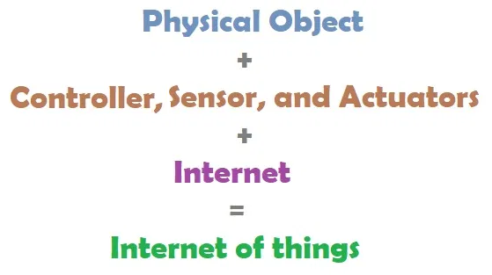
Prototyping online components
Prototyping IoT:
  Hardware- embedded devices, physical design
  Software- online/Internet components, embedded coding.

Slide 4
Prototyping online components …
IoT things will eventually communicate each other via their own standardized protocols.
As we do not have such solutions today, we consider the Internet principles (online components) for prototyping.
  Enable the IoT thing to talk to a service (in cloud) that you can control.
  Then enable this service to communicate with the online systems you need, in their data formats.
  Examples of online systems: Google, Facebook, State Highways Authority, Weather forecast, etc.

Slide 5
Communication with third parties
To obtain information from third party:
Apply information scraping
Application Programming Interface (API)- best when possible
Information scraping can be performed by:
Parsing their data such as html or text (e.g., scrapestorm)
Interpreting (recognizing) characters in screenshots- screen scraping
Also check for permissions on what the website/program owner allow you to do

Slide 6
REST
If you can't find a suitable 3rd party system for the data you need, maybe, you have to create the service yourself.
To communicate between the IoT thing (your app) and the service, you need a separate system.
Such system can be implemented in Representational State Transfer (REST) and JSON (or XML)
REST is an architectural style described by the constraints in https://en.wikipedia.org/wiki/Representational_state_transfer

Slide 7
REST ...
REST provides a neat and easy way to communicate with a service via existing protocols (e.g., HTTP).
In REST, you need not to worry about packets and data transfer.
It is easy for multiple things to get connected to at the same time.
  → Build a workflow using REST APIs and connect the Things

Slide 8
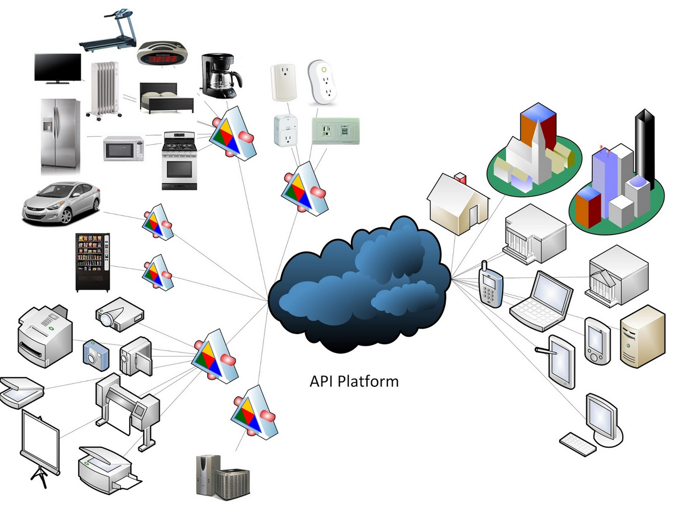
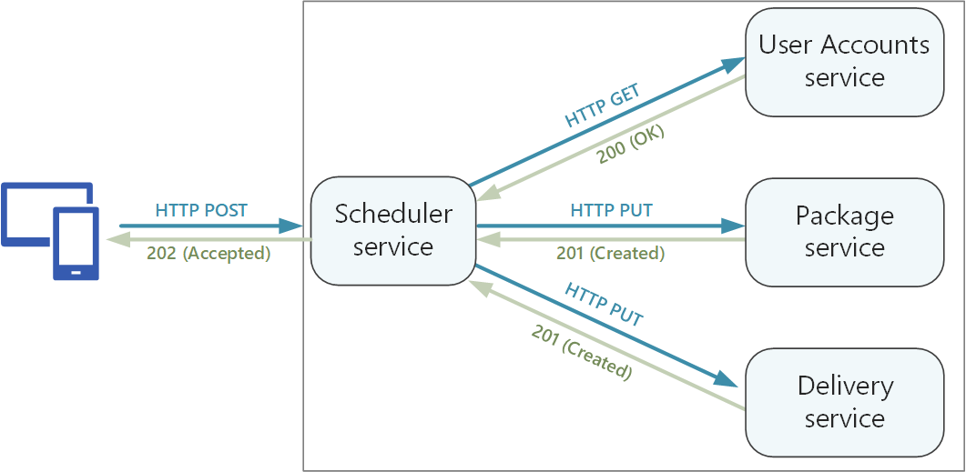
REST ...

Slide 9
REST ...
The REST API uses GET, POST, PUT and DELETE methods representing the CRUD operations in database systems.
Each REST command is a unique URL, and can hang on parameters.
REST can use various data formats like JSON and XML but JSON is less verbose in the way data is tagged.

Slide 10
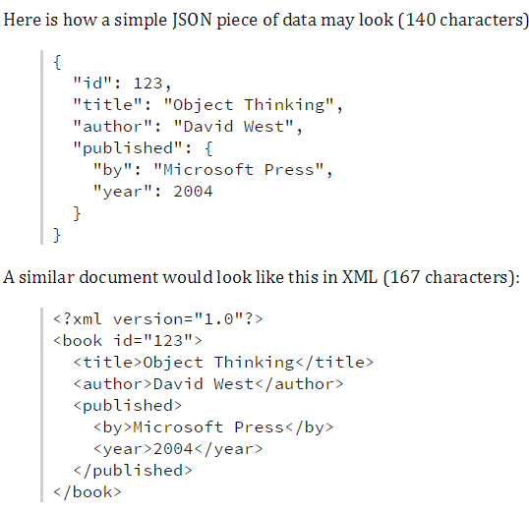
REST ...
Source: https://blog.quark.com/2016/08/xml-vs-json/amp/

Slide 11
REST ...
Advantages of the REST API
  Light weight design makes it less complex.
  Its performance is significantly fast.
  REST is designed for loose coupling, hence flexible.
  No footprint - directly invoked with HTTP without overhead.
  Reusability is virtually unlimited.
  Simple but lack of tools is attributed to more user concern.
  Loosely coupled and the Web is evident for its scalability.

Slide 12
REST ...
HTTP is very popular but not the only protocol for communicating with IoT things.
Example of HTTP-based REST interfaces can be found here.

Slide 13
REST ...
Other alternatives to HTTP are :
    MQ Telemetry Transport (MQTT)
    Extensible Messaging and Presence Protocol (XMPP)
    Constrained Application Protocol (CoAP)

Slide 14
Steering behaviors

Slide 15
Steering behaviors
The movement of an autonomous agent can be broken down into:
  Action selection- strategy, goals, planning
  Steering- path determination
  Locomotion- animation, articulation
Steering behaviors help autonomous agents move using simple forces that combine to produce life-like (improvised) navigation.
More information: www.red3d.com/cwr/steer/gdc99/
Notes:
Invented by C.W.R i 1983, Standard part of all AI courses, movement or the ability to move from one place to another
Improvise- create and perform (music, drama, or verse) spontaneously or without preparation. "he invited actors to improvise dialogue"

Slide 16
Steering behaviors
Characteristics of Autonomous agents:
  Maintain condition information (state) about itself
  When behavior is enabled, the agent can behave autonomously
  Can perceive surroundings and respond to it
Notes:
Invented by C.W.R i 1983, Standard part of all AI courses, movement or the ability to move from one place to another
Improvise- create and perform (music, drama, or verse) spontaneously or without preparation. "he invited actors to improvise dialogue"

Slide 17
Steering behaviors
Types of steering behaviors:
  Seek & Flee
  Pursue & Evade
  Arrive, Wander
  Wall Avoidance, Obstacle Avoidance
  Interpose, Hide, Path following, Offset pursue
Notes:
Invented by C.W.R i 1983, Standard part of all AI courses, movement or the ability to move from one place to another
Improvise- create and perform (music, drama, or verse) spontaneously or without preparation. "he invited actors to improvise dialogue"

Slide 18
Seek & Flee
Seek moving straight towards the target.
  It does not slow down as it approaches the target.
  Formula- [vector for steering power = vector for desired speed - vector for current speed]
  See example. https://www.youtube.com/watch?v=g1jo_qsO5c4
Flee is the opposite of Seek :
  It generates a force that moves the agent straight away from the target's position as quickly as possible.
  See example. https://www.youtube.com/watch?v=eantey2BaL4
Notes:
(Vis ”Seek” og ”Flee”.)
SEEK:
desiredVelocity = targetPos - agent.Position;
• desiredVelocity.Normalize();
• desiredVelocity *= agent.maxSpeed;
• return (desiredVelocity - fighter.velocity);
FLEE
The only difference is that the desiredVelocity is calculated using a vector pointing in the opposite direction (agent.Position - targetPos instead of targetPos - agent.Position).

Slide 19
Pursue & Evade
Pursue is useful for capturing/hitting a moving target :
Pursue calculates where the target will be at a given time and aim for it.
Evade is the opposite of Pursue:
Evade generates a force that moves the agent straight away from the target's assumed future position, as quickly as possible.
Notes:
(Show "Pursue", does not have an example for "Evade".)
Based on underlying SEEK and Flee

Slide 20
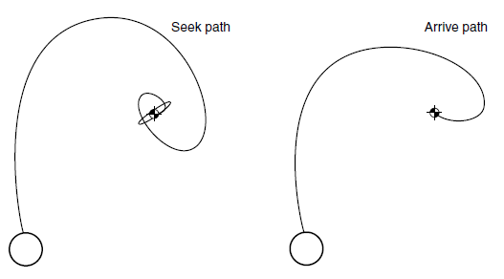
Arrive
Arrive takes into account a slowing speed as it approach a target- checks remaining distance & corrects the speed.
Example in Armed military drone:
  Seek- firing heat seeking missile
  Pursue- firing intelligent missile
  Arrive- when the drone should land
Notes:
(View "Arrive".)
Goal to arrive at target with zero velocity
Arrival behavior is identical to seek while the character is far from its target.
This behavior causes the character to slow down as it approaches the target, eventually slowing to a stop coincident with the target

Slide 21
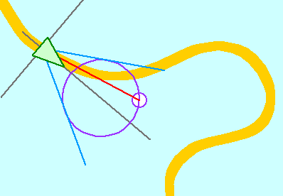
Wander
Wander is a nice way to generate movement in random direction, without it seeming twitchy.
Produce a realistic casual movement that makes the agent seem real and walking around.
It is just- seek with randomness
Source: http://www.red3d.com/cwr/steer/gdc99/
Notes:
(Vis ”Wander”.)
There are several ways to implement the wander pattern using steering behaviors. The simplest is using the previously described seek behavior. When a character is performing seek, it will move towards a target.
If the position of that target changes every few seconds, then the character will never be able to reach the target (and even if it does, the target will move again). Placing the target randomly in the game area will make the character eventually move around the whole environment chasing the target.

Slide 22
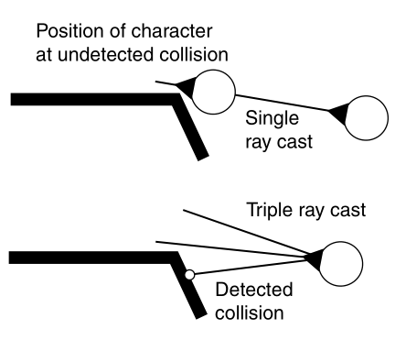
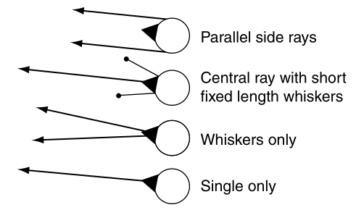
Wall Avoidance
Wall Avoidance is used to avoid walls/surfaces which operate with one or more feelers:
  If one or more feelers (horns) hit a wall, a force is calculated to move the agent away from the wall.
Notes:
Feelers = antennea
Create the feelers
– Take the default look vector * depth of the feeler
– Rotate it to create left, right ( Y Axis - yaw), up and down (X Axis - pitch) feelers
– Transform to world space (* the world transform)

Slide 23
Obstacle Avoidance
Smaller, sharp, and/or curved obstacles (instead of walls).
A more accurate (but expensive) alternative to steer clear of smaller obstacles is Obstacle Avoidance.
  All obstacles are seen as circles (spheres in 3D).
  The agent has a detection box in front of it- a square with width equal to the agent and length propositional with the speed.
  If there is (part of) an obstruction circle within the square, the agent must do an exception maneuver.

Slide 24
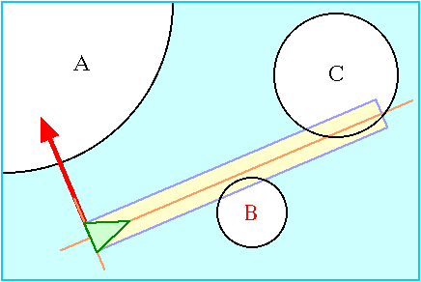
Obstacle Avoidance …
Brief description of the maneuvering algorithm :
  Obstacles that are out of reach of the square are ignored
  Remaining obstacles are checked if they collide with the square
  Resolve starting from a colliding obstacle closest to the agent, and steer clear!
Notes:
(Vis ”Obstacle Avoidance”.)
Any object that can be approximated by a circle or sphere
This is achieved by steering the vehicle so as to keep a rectangular area — a detection box, extending forward from the vehicle — free of collisions.
detection box's width is equal to the bounding radius of the vehicle, and its length is proportional to the vehicle's current speed — the faster it goes, the longer the detection box

Slide 25
Interpose
Interpose steering behavior attempts to put its agent between two other moving agents.
For example, a soccer player trying to block a pass between two members of the opposing team.
Like pursue, it predicts future position of the two other agents.
Then, determine a target point by interpolating between the future positions, and use seek to steer towards it.
Notes:
(Vis ”Interpose”.)

Slide 26
Hide
Hide involves identifying a target location on the opposite side of an obstacle from the opponent.
Then, the agent steer toward it using seek- has several uses:
  A victim who tries to stay hidden from a villain.
  With a little tweaking, a hero trying to shadow the villain or the villain trying to sneak in on the victim is not visible .
Notes:
Villain- (in a film, novel, or play) a character whose evil actions or motives are important to the plot.
Sneak in- to enter some place in a quiet, sneaky, inconspicuous, or furtive manner. The burglar snuck in without making a sound.

Slide 27
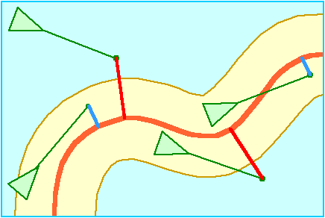
Path following
Path following enables an agent to steer along a predetermined path.
It intends to produce motion parallel to the centerline of a- roadway, corridor or tunnel, but are free to deviate from it.
The agent navigates from node to node until it reaches end of route.
Every node in the path is seen as a target, so the seek behavior can be used and example of such use is in patrolling.
Notes:
Patrolling- keep watch over (an area) by regularly walking or travelling around it.

Slide 28

Offset pursue
Offset Pursue is to constantly try to hold a given position relative to the target.
For example, an aircraft flying near enough to be within sensor range- a simplified procedure is below:
  First, the correct offset is calculated from the target.
  Then Pursuit is used to assume where the target position will be.
  Finally, Arrive (not Seek) is used to move to this position.
Notes:
(Vis ”Offset Pursuit”.)
Offset pursuit is useful for all kinds of situations. Here are a few:
Marking an opponent in a sports simulation, Docking with a spaceship, Shadowing an aircraft, Implementing battle formations …
A pursuit is the process of following a target aiming to catch it. It's important to note that the word "catch" makes all the difference here. If something is just following a target, all it has to do is repeat the target's movements and, as a consequence, it will be on its track.

Slide 29
Flocking
Flocking is a combined steering behavior from separation, cohesion, and alignment movement of groups of agents.
  Each agent determines how react in local neighborhood (ignored otherwise).
  Local neighborhood → defined by distance between two nearby agents and an angle of their perceptual “field of view.”
  Each agent knows only about itself and closest agents- the effect is reminiscent of a fishing line or bird flock.
The link below contains example of simulating the steering behaviors: https://mugen87.github.io/yuka/examples/
Notes:
(Show "Flocking / Big Shoal".)
* Separation • * Cohesion • * Alignment • Wander
• Sphere Constrain • Obstacle avoidance • Flee
Alignment steering behavior gives an character the ability to align itself with (that is, head in the same direction and/or speed as) other nearby characters, as shown in Figure 16. Steering for alignment can be computed by finding all characters in the local neighborhood (as described above for separation), averaging together the velocity (or alternately, the unit forward vector) of the nearby characters. This average is the “desired velocity,” and so the steering vector is the difference between the average and our character’s current velocity (or alternately, its unit forward vector). This steering will tend to turn our character so it is aligned with its neighbors.

Slide 30
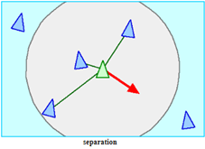
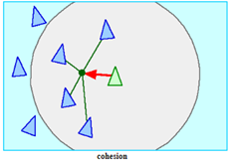
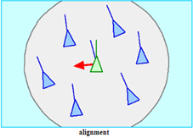
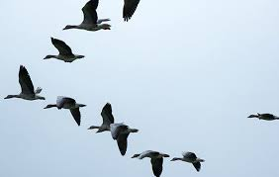
Flocking
Notes:
(Show "Flocking / Big Shoal".)
* Separation • * Cohesion • * Alignment • Wander
• Sphere Constrain • Obstacle avoidance • Flee
Alignment steering behavior gives an character the ability to align itself with (that is, head in the same direction and/or speed as) other nearby characters, as shown in Figure 16. Steering for alignment can be computed by finding all characters in the local neighborhood (as described above for separation), averaging together the velocity (or alternately, the unit forward vector) of the nearby characters. This average is the “desired velocity,” and so the steering vector is the difference between the average and our character’s current velocity (or alternately, its unit forward vector). This steering will tend to turn our character so it is aligned with its neighbors.

Slide 31
Mentimeter discussion points
Why is it important to go through our own online service in IoT implementation?
Follow the link below (or use similar resource) and discuss about REST interfaces as well as their outputs (responses). https://stackify.com/rest-api-tutorial/
What are the constraints of the REST architecture? Use the following resource and discuss- https://medium.com/future-vision/what-are-the-constraints-of-rest-and-how-they-saved-the-internet-6fb8503138ab
Choose a data set (record) and describe it in both JSON and XML. Use the same field names and actual data. Count the total number of characters in each and write on a sticky note and compare results.
Explain each of the following steering behaviors- Seek & Flee, Pursue & Evade, Arrive, Wander, Wall Avoidance, Obstacle Avoidance, Interpose, Hide, Path following, and Offset pursue.
Notes:
Reason for owning online service- To have control without a layer between IoT things and 3rd party. The things may stop working if a 3rd party changes its solution!

Slide 32
Next themes
Techniques for Writing Embedded Code
Business models

